Slide 1
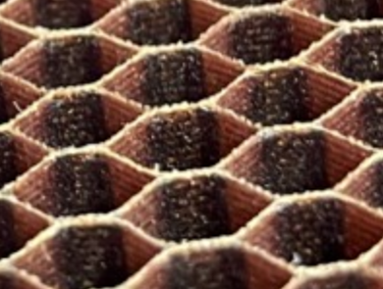
Click here to type Title of Poster in this Section
(use both Upper & lower letters & try not to exceed 3 lines – you can reduce font size slightly to get it to fit)
Delete this box and place Author 1 photo here.
Delete this box and place Author 2 photo here.
Delete this box and place Author 3 photo here.
Delete this box and place Author 3 photo here.
Abstract: This section holds your abstract. Make it short and concise so it pops out for judges to review. Ask yourself, what were your goals, what did you accomplish, and what did you learn?
Author 1, Author 2, Author 3, Author 4,
University & Department
delete or add photo boxes based on the number of authors
Text describing your overall research program goes into 3 columns. Basic text is set for Calibri 22 pt. The section headings are set to Calibri 26 pt and Bold font. If you don’t have that font loaded, use another sans-serif font like Arial or Helvetica.
To start, just click on the section heading and change to your words. Then to enter text just highlight the existing text and start typing.
Alternatively, you can try cutting and pasting type from
another document into these text boxes, but make sure you reformat the type properly afterward.
Often the first section is filled with your introductory materials and titled “Introduction” or maybe “Background”. This is where you give the motivation for your work.
This is the second section. You can move the “Second Section Heading” box up and down to match your text. The second section would often where you would put your methods. Maybe it is your experimental setup section, or your math development?
Pictures are strongly encouraged! Figure 1, shown below, is an example figure.
And you can add text under a figure if you need.
To continue writing in the next column, just click on the text here and start typing, hitting a carriage return to get to the next line. It’s good to make sure you state your project goals, your experimental setup, materials tested, how you conducted your experiments, any special changes you needed to make, and results. You’ll list your summary/conclusions and next steps in the box at the bottom of the poster.
The section headings do not need to align at the top of the column. But if you can make things fit it often flows better.
You can have multiple figures in a column. Careful about having the font size in the figure match the rest of the poster. Try to target something between 16 pt and 24 pt for consistency.
To continue writing in this last column, just click on the text here and start typing, hitting a carriage return to get to the next line.
Again, move your section headings over as you need.
Don’t forget to acknowledge any funding sources!
NOTE: FINAL PRINT SIZE SHOULD BE 24” WIDE AND 36” TALL.
First Section Heading
Another Section Heading
Second Section Heading
22.89
mm
18.86
mm
13.68
mm
4-layer laminates for each facesheet
(a)
(a)
Figure 2: Schematic of coupon, (a) Nomex core with fabricated holes and (b) honeycomb sandwich panel.
Figure 1: Type in your figure caption here. This section is 22 point font.
Summary and Conclusions: In this last section, you will type your summary & conclusions, plus next steps. Try not to exceed 4 lines, so be concise. You can make type slightly smaller to fit but please don’t make it too small. We want your conclusions to pop out to judges.
Student Poster Competition Sponsored by

